Slide 1
Weeding with Friends
A Collection Management Workshop for Public Libraries

Slide 2
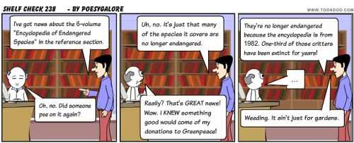
Why weed library collections?

Slide 3
Is there a method to this madness?
CREW (continuous review, evaluation, and weeding)
https://www.tsl.texas.gov/ld/pubs/crew/index.html
MUSTIE (misleading, ugly, superseded, trivial, irrelevant, or obtained elsewhere)
https://aislibrary.weebly.com/weeding-guidelines.html
The Collection Development Policy

Slide 4
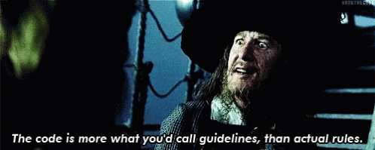
The final decision is always yours!

Slide 5
What is your criteria?
Just the basics?
Circulation
Condition
Creation date (older than 5 years)
Duplicates
Full evaluation?
Current
Factual
Local importance
Number of items on the topic
Space
Notes:
Some of your criteria will depend on your reason to weed. If you have completely run out of space on your shelves I would use the basics and run a report on based on the last circulation date. DENA Simply Reports makes everything so easy!
If you want to make sure the library’s collection is current you might do the full evaluation. More than likely you will end up doing a combination of both depending on your time and needs!

Slide 6
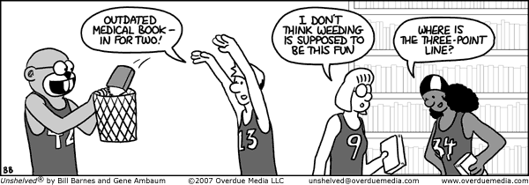
Where to start?

Slide 7
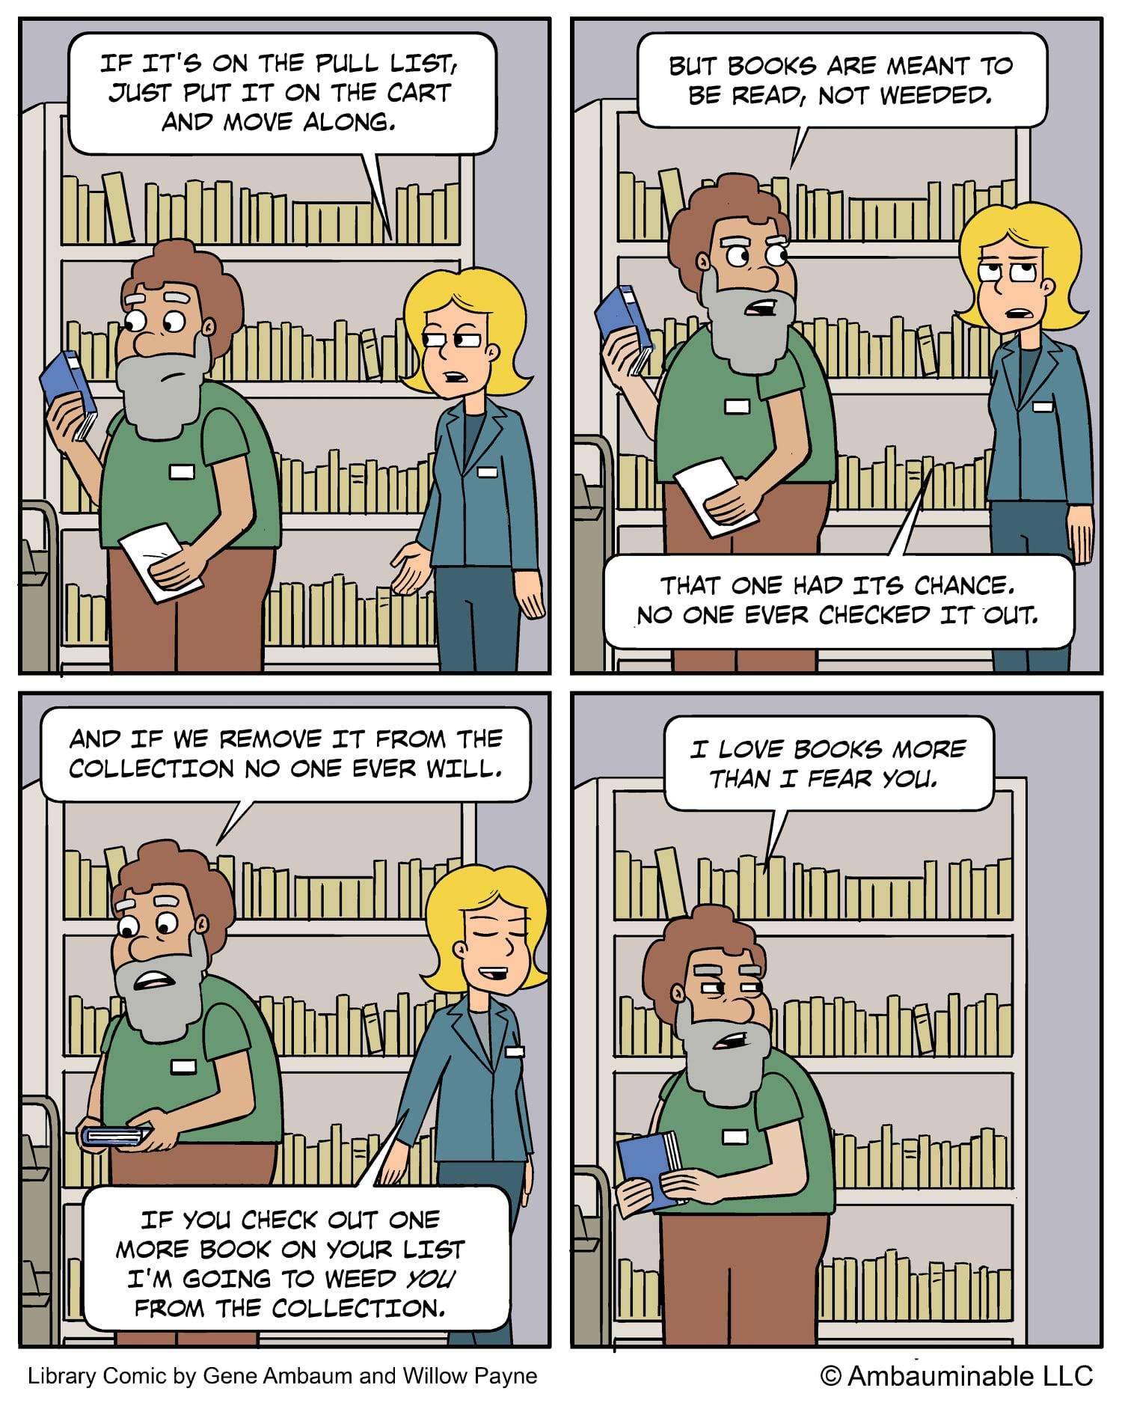
What if you really don’t want to weed an item?
“Classics” are important to keep in the collection
Give items with diverse characters and/or authors a little extra shelf time
Keep series intact
Create a book display
Check it out or convince a coworker to read it

Slide 8
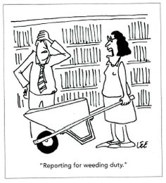
What to do with all the weeded books?
Friends of the Library Book Sale
Bookish Craft Programs
Bulk resellers like Better World Books
Free Little Libraries
Trash

Slide 9
How do you fit this into the day?
Discard books bad condition after they are checked in and before they get put back on the shelf
Choose one area at a time
Block off a chunk of time on your calendar for weeding during a slow part of the day
Keep it up! Once you have started, each time it gets easier

Slide 10
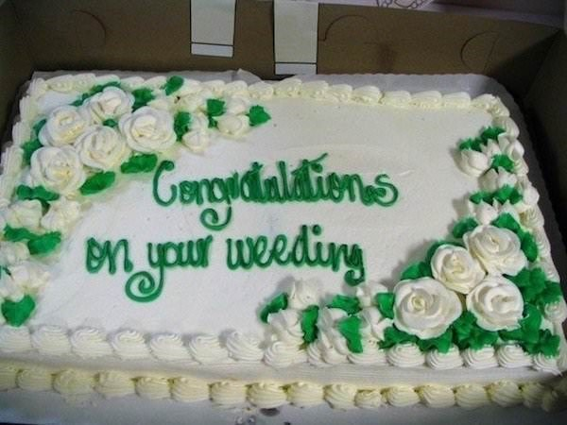
If you still need moral support - here is my contact information:
Betsy Mahoney
betsymahoney@smrld.org
618-501-4785

