Slide 1
Polaris Reports for Weeding
Dena Porter, SHARE Administrative Services Manager
Weeding with Friends• Nov. 13, 2024
Notes:
My name is Dena Porter, I am the SHARE Administrative Services Manager.

Slide 2
Agenda
Canned Polaris reports
SimplyReports
Weeding Workflow in Leap
Questions?
Notes:
The topics I will be discussing are the canned reports in Polaris, SimplyReports, and for you Leap users I will give a brief overview of a new option in Leap, Weeding Workflow.

Slide 3
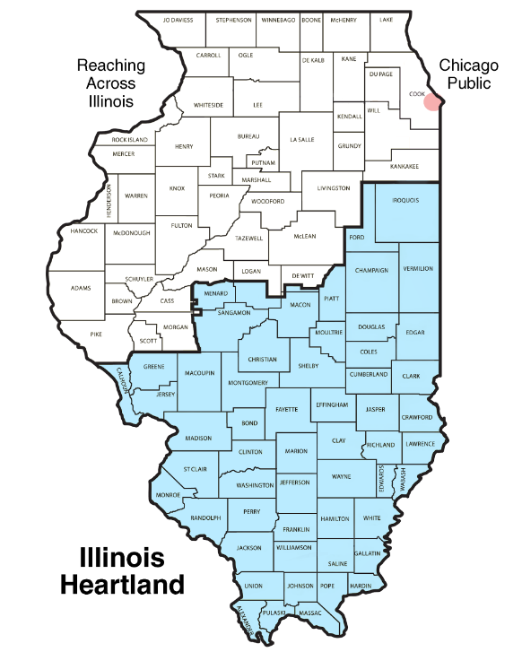
What is SHARE?
Sharing Heartland’s Available Resources Equally
Collection of libraries in central and southern Illinois
362 libraries at 480 locations
Largest Automation Consortium in North America
Almost 9 million items • 800,000 patrons •
6.7 million items checked out in FY2024
Notes:
What is Share?
Sharing Heartland’s Available Resources Equally
368 libraries at 480 locations
Largest library consortium in North America
When I last checked, we were at almost 9 million item records and close to 800,000 registered patrons.

Slide 4
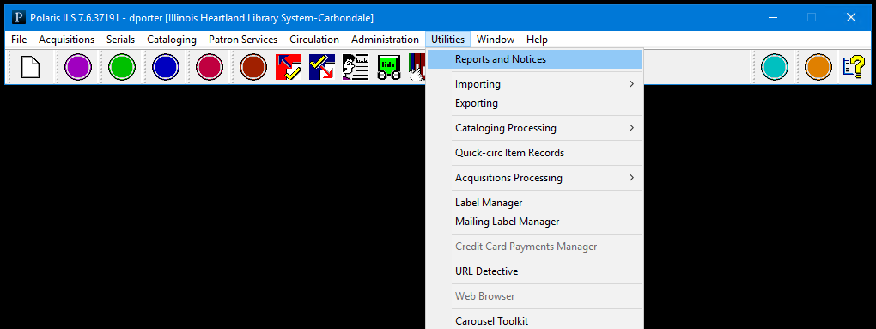
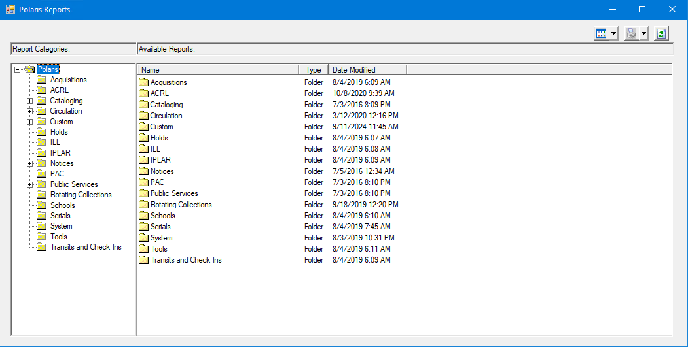
Canned Polaris Reports
Utilities→Reports and Notices
Notes:
Let’s begin with the canned reports in Polaris. When you first open reports and notices it can be a little overwhelming is you are not over familiar with the reports. As you can see, there is no way to search for a report, you just have to start digging. For weeding there is not really any report that stands out, to me at least, that aids in weeding.

Slide 5
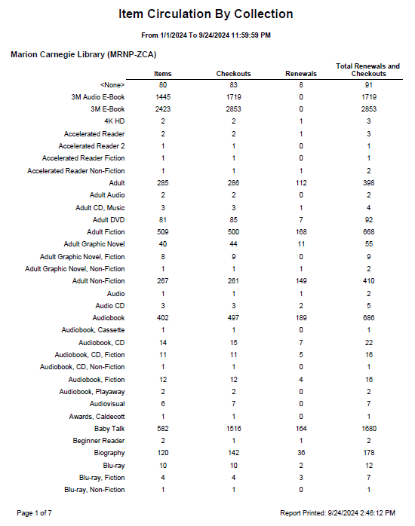
Canned Polaris Reports
Item Circulation by Collection
Found in Circulation folder
Notes:
Item Circulation by collection is great to get an overall snapshot of your library’s collections; this report will give you the number items that were checked out and/or renewed during a certain timeframe. Keep in mind, this will show every collection of an item that was checked out at your library. In this example I used my old stomping grounds, Marion Carnegie Library. You see page one of seven. As the former cataloger there I know they do not have a collection named , Blu-Ray Fiction, even though you are seeing it listed that means 4 items were checked out there, form another library, that use that collection name.

Slide 6
Adding Reports To Custom Folder
Right-click on report name
Select “customize”
Notes:
We always get a lot of report questions, and that would be a whole other session, but I wanted to quickly let you know you have the option to customize your library custom folder. If you look in the report categories there is a folder labeled custom and every library has a custom folder. Any report that you run often, even everyday you can add that to your folder. For example: if you really like the Item Circulation by collection report you can add it by right clicking on the report title then select customize. Once you do this the report will be in your library’s custom folder.

Slide 7
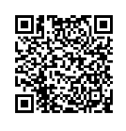
SimplyReports
https://ihlsrpts.illinoisheartland.org/SimplyReports/
Notes:
For SimplyReports. I have a QR code that will link you to our SimplyReports sits. When you are logging in you will use your username and password that you use for Polaris, but in the username field, you will just enter your first name.Last name. SimplyReports is permission based, so please let me know if you are not able to get logged in, as we don’t automatically put these permissions in place

Slide 8
SimplyReports
Notes:
When the page is opened you will see the SimplyReports landing page, this is where you will create reports. It looks and can be a little overwhelming, but once you use the site a few time you will be a pro!

Slide 9
SimplyReports
Item Assigned Collection Name
Item Barcode
Item Call Number
Item Creation Date
Item Last CKO/Renewal Date
Lifetime Circulation (Not YTD)
MARC Author
MARC Title
Notes:
This is my go-to report when libraries ask for a report for weeding.

Slide 10
Leap Weeding Workflow
Leap offers a workflow with permissions for staff and managers to take different roles while weeding item or bibliographic records. Use to add more control over weeding or to streamline updates to weeded items.
Uses a set of tools to aid with weeding:
Weeding templates
Weeding record sets
Leap Approval Dashboard

Slide 11
Leap Weeding Workflow Steps
Create a weeding template
Create a weeding record set
Add items to record set
Submit for approval
Approve or decline
Notes:
Here are the steps for the weeding workflow written out, let’s review each one.

Slide 12
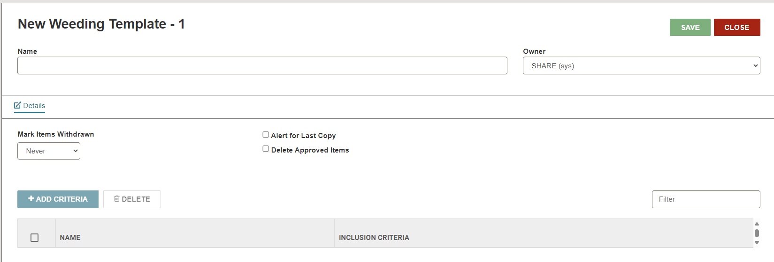
Step
Create Weeding Template
Defines criteria of what items is to be weeded
Based of criteria items maybe rejected or flagged
Can be set to automatically update circulation status and item record status
Notes:
The template defines the criteria of what is to be weeded using item record fields. Items may be rejected or flagged based on the template values. Additionally, the weeding template can be set up to automatically bulk update item circulation status and item record status, cutting out the need to separately bulk update the items.

Slide 13
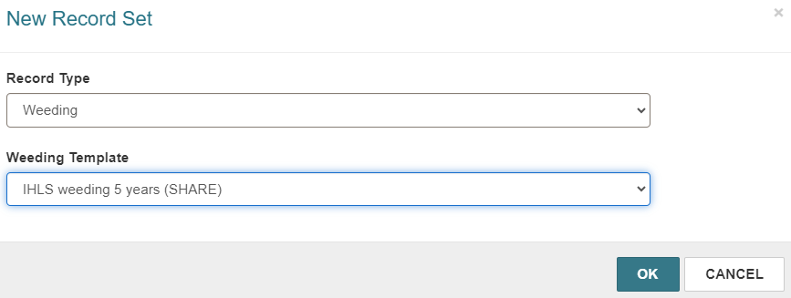
Step
Create Weeding Record Set
Add items to be weeded
Weeding template dictates the criteria (rules) of the weeding record set
Notes:
Once your weeding templates are set up, staff can begin creating weeding record sets and add items to be weeded to the set. The weeding template dictates the rules of the weeding record set.

Slide 14
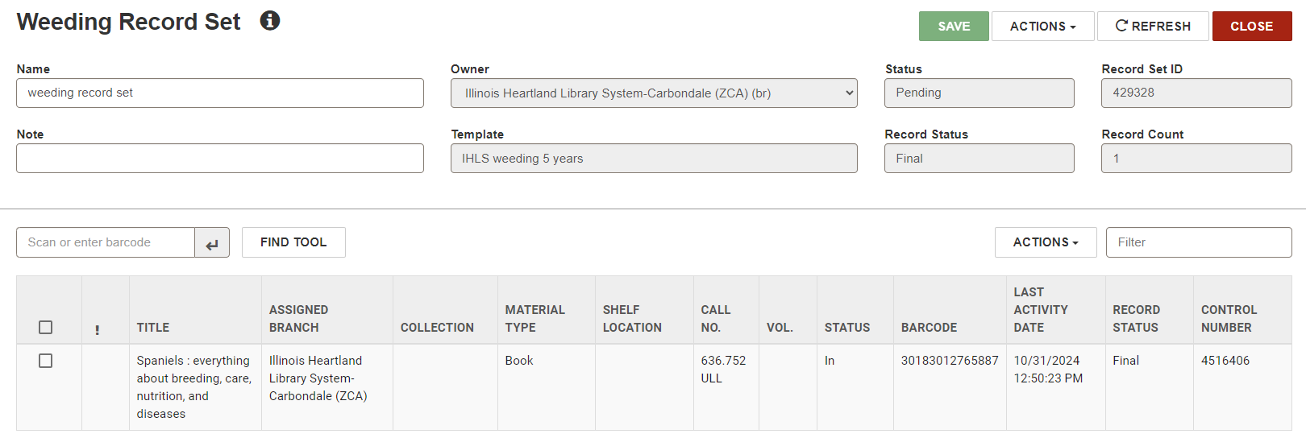
Step
Add items to Record Set
As items are added, they may be rejected or flagged based on weeding criteria
Notes:
As you add items to the set, the set may reject or flag item records based on weeding template settings.

Slide 15
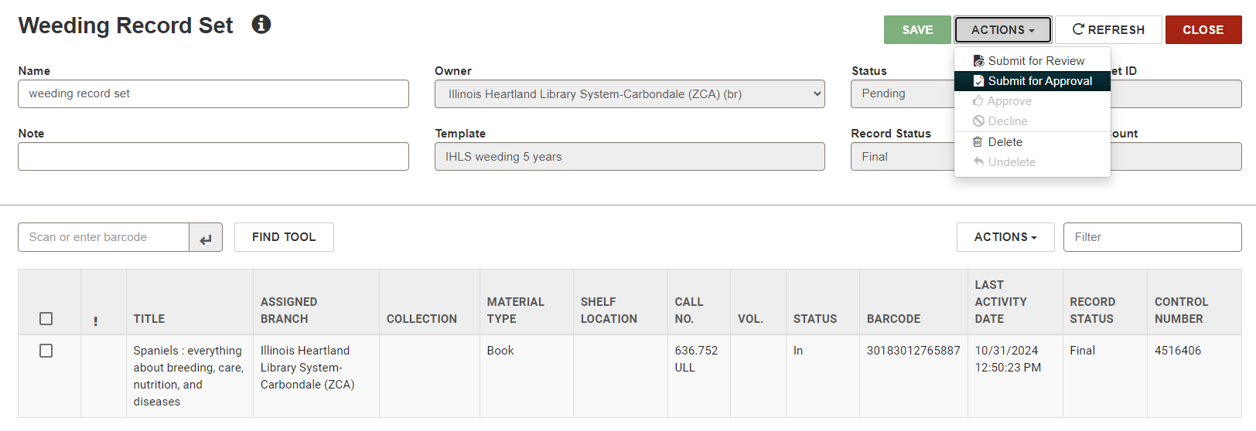
Step
Submit Record Set for Approval
Notes:
When ready, the record set is submitted for approval.

Slide 16
Step
Approve or Decline Record Set
Weeding record set will appear in Leap’s approval dashboard (utilities)
Staff, with permissions, will approve or decline the submitted record set
If approved, the record set will apply the template record options. If declined, the items will not be weeded.
Notes:
After submission, the record set will appear in a new Leap utility, called the Approval Dashboard. Staff with the proper permissions can approve or decline the weeding record set. If approved, it will apply the record update options as defined by the template. If the record set is declined, the items will not be weeded.

Slide 17
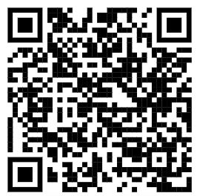
Additional Resources
SHARE website
SimplyReports Manual, Sample Reports, & Login Link
https://share.illinoisheartland.org/other-services/simplyreports
Cooperative Computer Services (CCS)
Leap Tools for Weeding webinar-
https://www.youtube.com/watch?v=KQ2FBGKFKSg

Slide 18
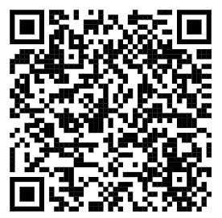
Additional Resources
Innovative
Weeding Workflow Deep Dive
https://vimeopro.com/innovativeiii/webinars/video/933410242

Slide 19
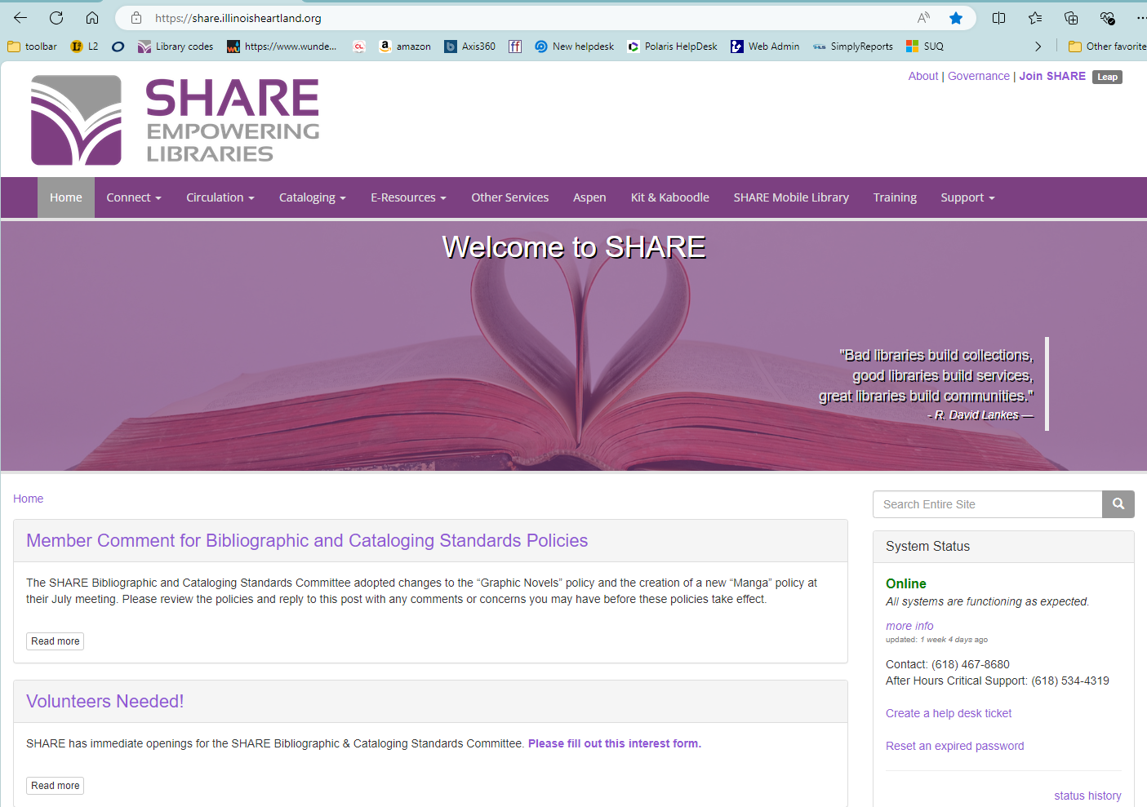
SHARE Website
www.share.illinoisheartland.org

Slide 20
Questions?

Slide 21
Contact Information
Dena Porter • SHARE Administrative Services Manager
dporter@illinoisheartland.org
618.619.2091

