Slide 1
Document Accessibility Essentials: A Step-by-Step Guide from Word to PDF
John Kirchner, SHARE Member Engagement Specialist
Notes:
I have been spear heading accessibility at IHLS for over a year. As part of my position is managing documents for SHARE Committees, I am most familiar with document accessibility.

Slide 2
Overview
Intro on Accessibility Standards
Making a document accessible in Word
Converting to PDF and remediation in Adobe Acrobat
Resources and tools
Q & A
Notes:
I will be moving back and forth between this Powerpoint and the minutes document that was posted on L2. Much of the information on the slides is designed to be used as a resource (lots of step by step instructions), so I may skip some slides since I will be going over the topic on the minutes instead.

Slide 3
Disclaimer
This presentation in no way ensures ADA or Section 508 compliance. The strategies shown may not be sufficient for every document or situation.
I am not a lawyer

Slide 4
The DOJ and the ADA
“State and local governments” serving a population more than 50,000 must meet WCAG 2.1 by April 26, 2026 to be compliant with the Americans with Disabilities Act (ADA).
Smaller organizations have until April 24, 2027.
Notes:
On April 24 of 2024, the DOJ published a rule updating Title II of the ADA, detailing specific requirements on ensuring web content is accessible to people with disabilities. This includes documents that are attached to library websites.

Slide 5
WTH is WCAG!?
WCAG stands for “Web Content Accessibility Guidelines” and was developed by the World Wide Web Consortium (W3C).
Four guiding principles: POUR
Perceivable
Operable
Understandable
Robust

Slide 6
WCAG Success Criteria
There are 13 “Success Criteria” in WCAG 2.1
Each criterion has several conformance levels.
Ex: To meet the AA level for text contrast, there must be a contrast ratio of at least 4.5:1 between text and the background. Level AAA requires a ratio of 7:1.
You must meet level AA in all success criteria
Notes:
STOP HERE FOR QUESTIONS

Slide 7
Accessibility in MS Word

Slide 8
Starting Tips
Enable the Navigation Pane in the View Tab
Enable Hidden Characters “¶” under the paragraph section of the Home Tab
Note: The version of Word used in this demo is Word 365, the version included in an Office 365 subscription. The desktop version of Word is required.

Slide 9
Metadata
Every document must have a title (title is different from file name)
In Word File → Info → Properties

Slide 10
Headings
Headings allow AT users to skim through content more easily
Headings inform the user of the document structure and hierarchy
Usually there will only be a single H1 heading, which is often the title
Never skip heading levels

Slide 11
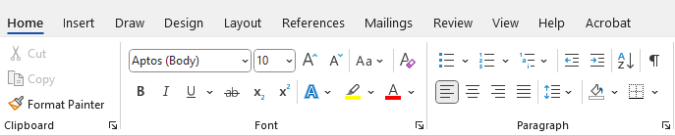
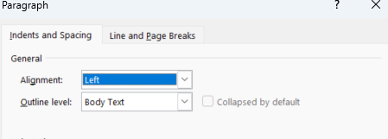
Headings Cont.
Select heading, then open the paragraph menu and select heading level under “Outline level.”

Slide 12
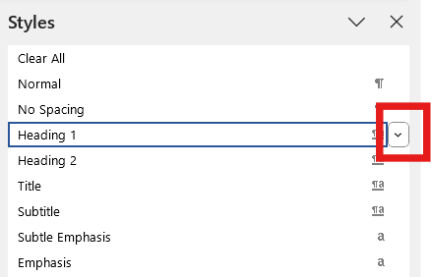
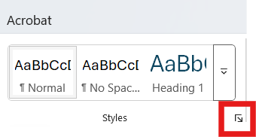
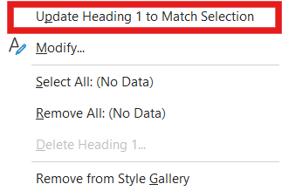
Styles
The Styles Pane can also be used to assign headings.
Notes:
STOP HERE FOR QUESTIONS

Slide 13
Alternative Text
Succinct, descriptive, and context-based
Most screen readers can’t skim alt text
Consider if alt text is necessary – don’t repeat anything already stated in the caption or text
Mark figures not requiring alt text as “decorative”

Slide 14
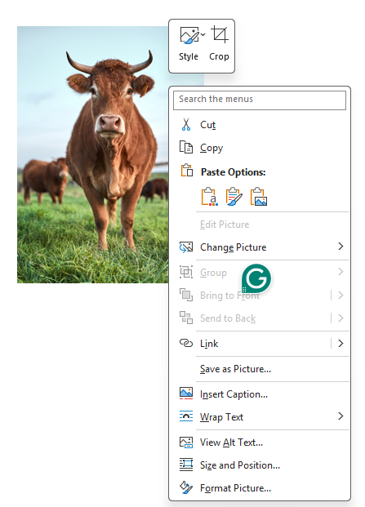
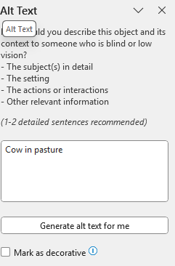
Alternative Text Cont.
Right-click on image → select “view Alt text” → type in box OR mark as decorative

Slide 15
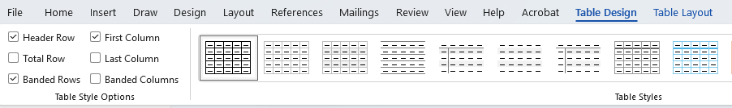
Tables
NEVER use tables for formatting.
Only used for tabular data – if information can be expressed outside a table, then do so.
All tables must have a defined header row. Click on table → open “Table Design” tab → check “Header Row” box on the left.
Avoid blank and merged cells.
Notes:
If possible, use the NVDA Screen Reader to demonstrate.

Slide 16
Converting to PDF
Do NOT use the print menu to save as a PDF
File → “Save as” or “Save a copy” → Select PDF from dropdown → “More Options” → “Options” → Document structure tags for accessibility → select OK and save
Notes:
STOP HERE FOR QUESTIONS

Slide 17
Accessibility in Adobe Acrobat

Slide 18
PDFs and You
Portable Document Format (PDF) was developed by Adobe in 1992
Assistive technology uses the tag structure of PDFs to read them
Must have Adobe Acrobat Pro to tag PDFs and edit tags*
The easiest way to make PDFs accessible is to not use them!
Notes:
*There are alternative platforms for pdf editing, but I cannot speak for their cost or effectiveness.

Slide 19
Acrobat Accessibility Settings
Tags Pane
View > Show/hide > Navigation Panes > Accessibility Tags
Tools
Accessibility
Preflight
Note: I use the “old” user interface of Adobe Acrobat for this demo. If your version of Acrobat is set to the “new” UI, here are instructions to revert to the old version.
Notes:
STOP HERE FOR QUESTIONS

Slide 20
Checking for Compliance & Remediation
Always use an automated checker
PDF Accessibility Checker 2024
While both the Word and Adobe accessibility checkers are helpful, neither are comprehensive

Slide 21
Other Considerations
Word documents are not the only documents that can be converted into PDFs
PowerPoint files, spreadsheets, and files made on Canva are all often converted in PDFs and must be made accessible

Slide 22
To PDF or not to PDF?
PDF Remediation is time-consuming
PDF are not as secure as often assumed
Putting the same information on a webpage with HTML is much more accessible. Example: Winfield Public Library Minutes
.docx files can also be attached instead of PDFs
Notes:
It is estimated that remediating pdfs can take approximately an hour per page.

Slide 23
Resources & Tools
DOJ ADA Title II Factsheet
WCAG 2 Overview
PDF Association Accessibility
PDF Accessibility Class on LinkedIn Learning
PDF Tags and Their Uses
NVDA Screen Reader
WebAIM Resources and Tools
PAC 2024
RAILS Digital Accessibility
Notes:
Web Aim is developed by the Utah State University

Slide 24

Q & A

